Slide 1
Advanced Image and Video processing
Under the supervision of
Dr. Mai Kamal El Den
By
Eng. Omar abdelhameed

Slide 2
Image Enhancement in the Spatial Domain
Today
Image Enhancement Techniques
Spatial Domain Method

Slide 3
Image Enhancement
Enhancement Methods
Spatial Domain:
Operates on pixels
Frequency Domain:
Operates on FT of image

Slide 4
Image Enhancement Methods
Spatial domain methods
Point-based methods
Mask-based (neighborhood-based) methods : Spatial filltering
Frequency domain methods
Techniques are based on modifying the Fourier transform of an image

Slide 5
Point-based methods
Image Negative
Log Transformation
Power-Law
Gray-level slicing
Bit plan slicing
Contrast Stretching
Histogram

Slide 6
Spatial domain methods
In these methods a operation (linear or non linear) is performed on the pixels in the neighborhood of coordinate (x,y) in the input image F, giving enhanced image F
Nighborhood can be any shape but generally it is rectangular (3*3 , 5*5, 9*9 ect)
g(x,y) = T[f(x,y)]
Where f(x,y) is the input image
g(x,y) is the processed image
T is an operator on f defined over some neighborhood of (x,y)

Slide 7
Grey Scale Manipulation
Simplest from of window (1*1)
Assume input grey scale values are in range
[0 , L-1] (in 8 bit images L = 256)
Where, s and r variables denothing, respectively, the intensity of g and f at any point (x,y).
S= T(r)

Slide 8
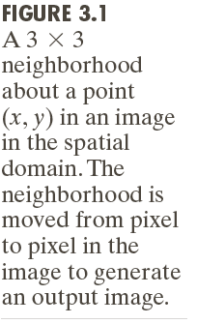
Background
g(x, y) = T[f(x, y)] => s = T(r)

Slide 9
gray-level transformation functions
Linear: Negative, Identity
Logarithmic: Log, Inverse Log
Power-Law: nth power , nth root

Slide 10
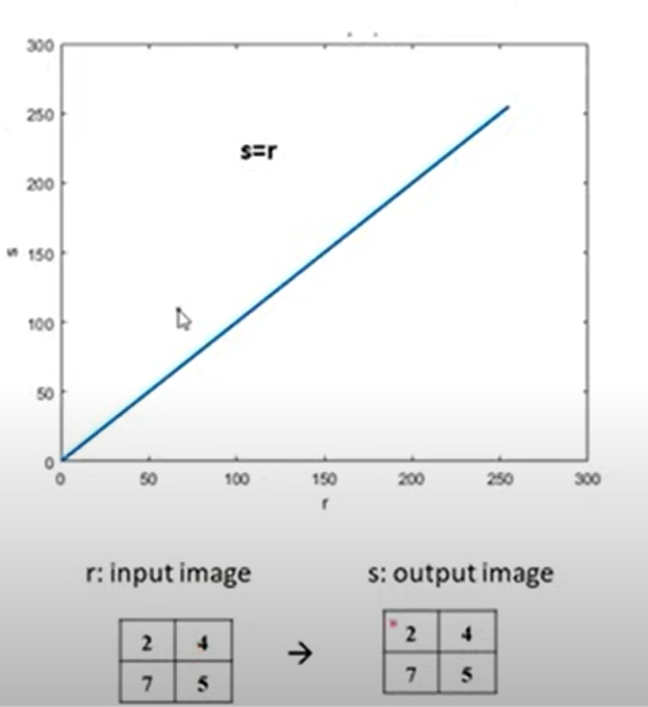
Identity transformation
Output image is same as input image
r:input image
s:output image

Slide 11
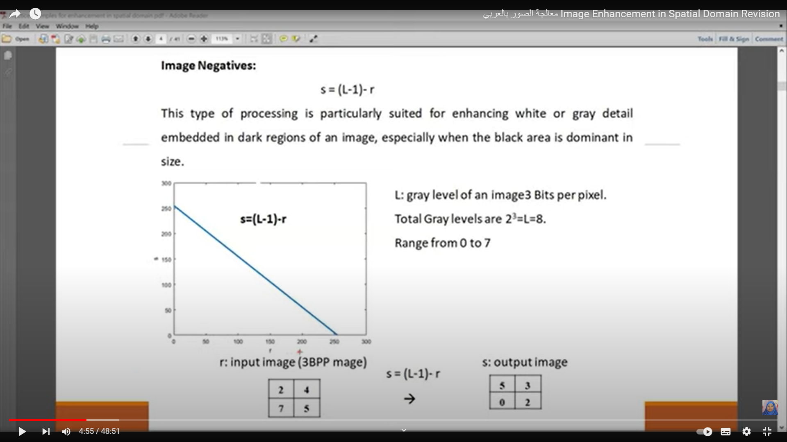
Image Negative
An image with gray level in the range [0, L-1]
Negative transformation : s = L – 1 –r
Reversing the intensity levels of an image.
Suitable for enhancing white
or gray detail in dark
background.

Slide 12
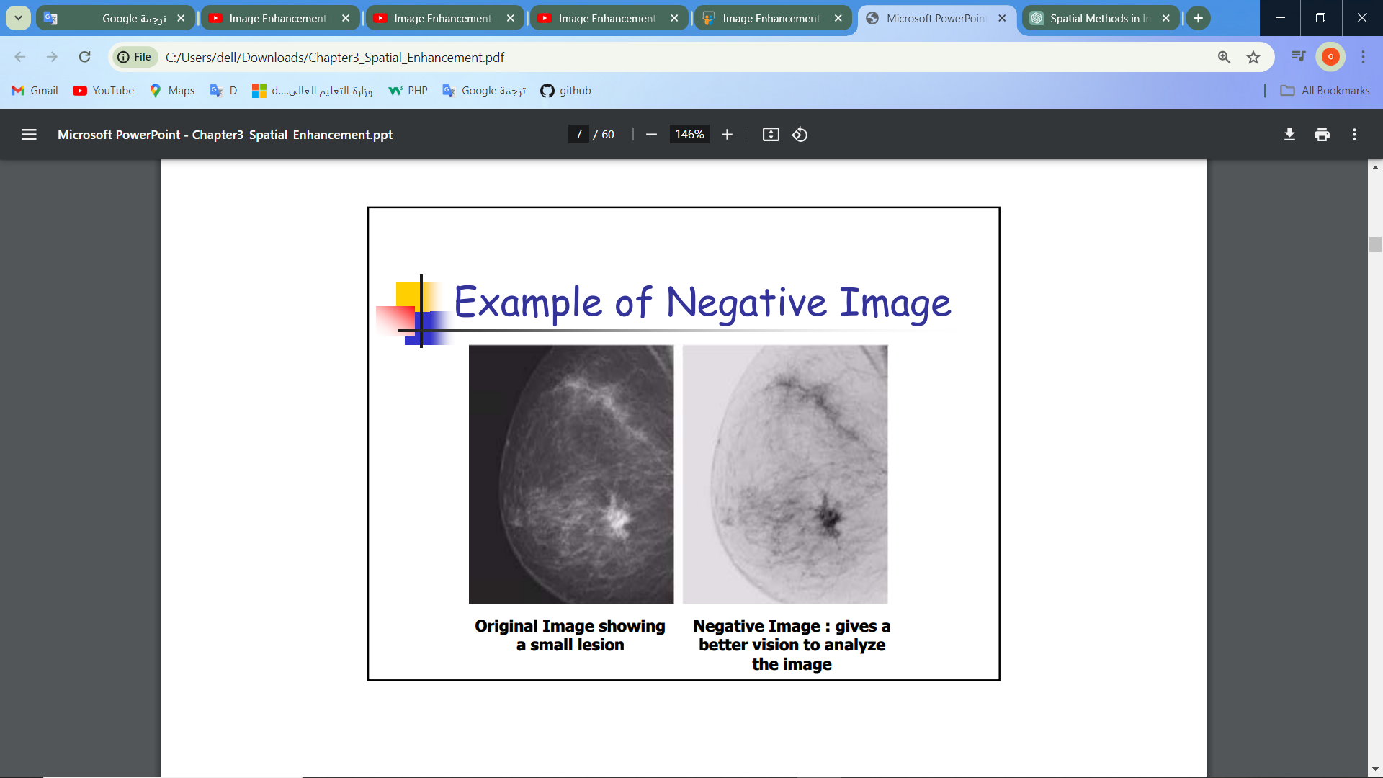
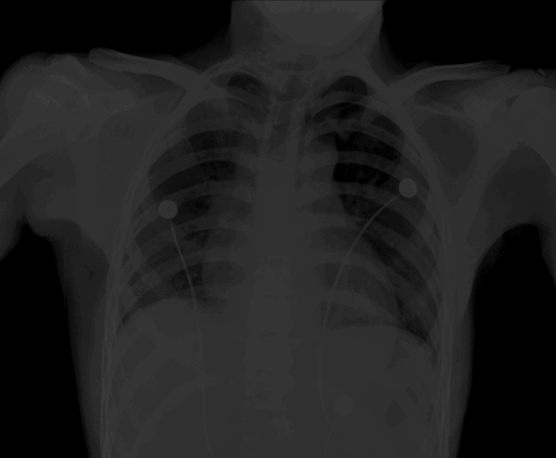
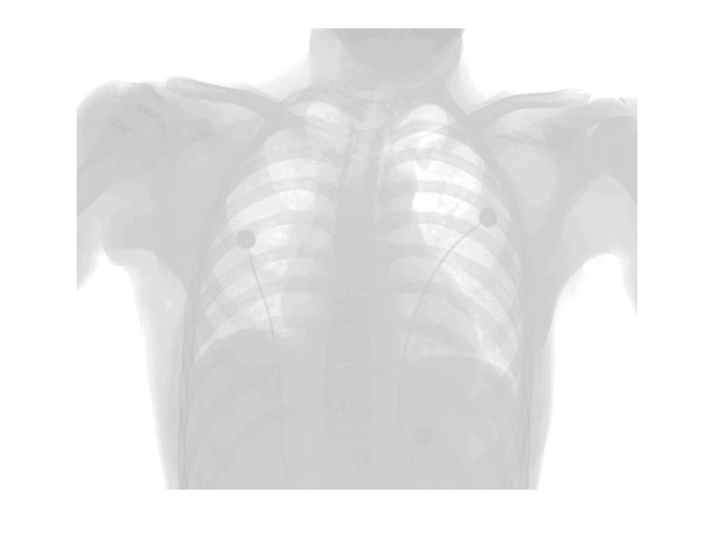
Example of Image Negative

Slide 13
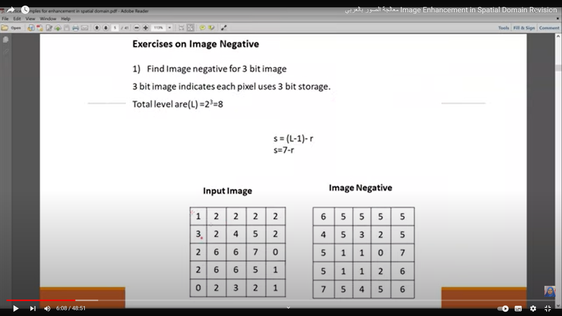
Exercises on Image Negative
1) Find Image negative for 3 bit image 3bit image indicates each pixel uses 3 bit storage.
Total Level are(L) = 2^3 = 8

Slide 14
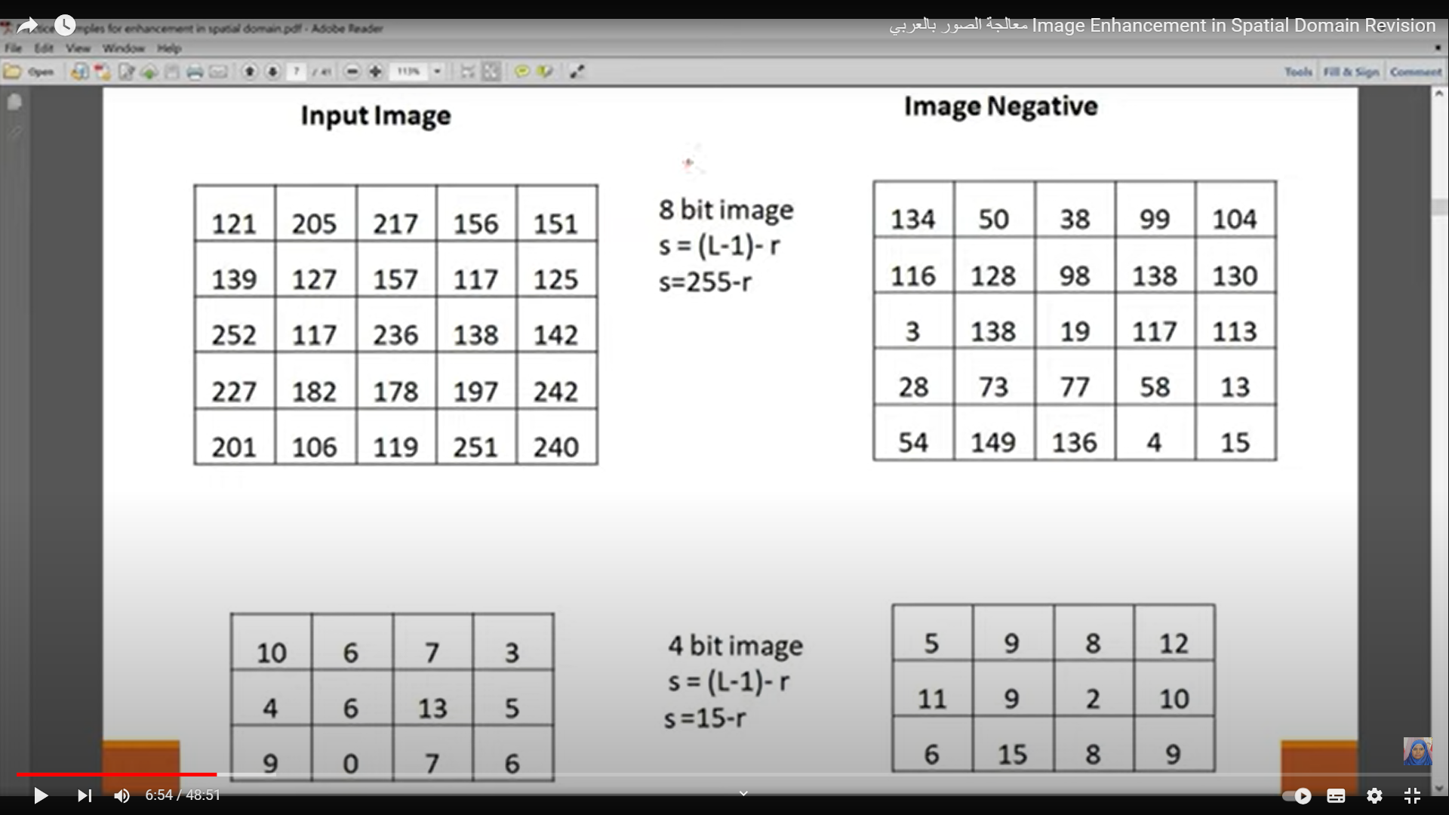

Slide 15
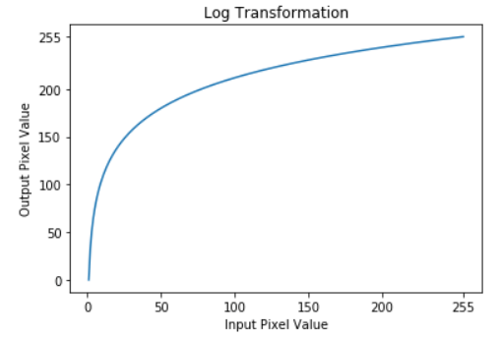
Log Transformations
s = c log (1+r)
c is a constant and r ≥ 0
Log curve maps a narrow range of low gray-level values in the input image into a wider range of output levels.

Slide 16
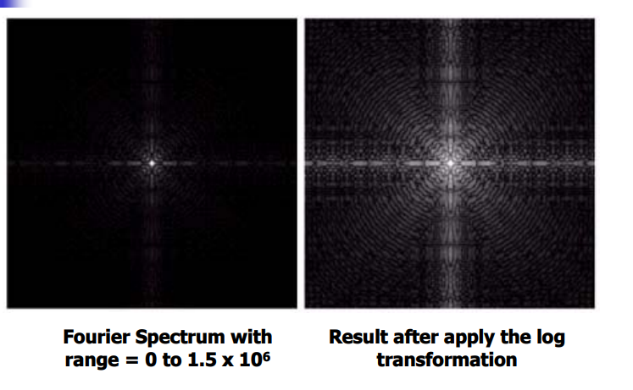
Example of Logarithm Image
Expand dark value to enhance details of dark area

Slide 17
Power-Law (Gamma) Transformations
s = crγ
c and γ are positive constants
Power-law curves with fractional values of γ map a narrow range of dark input values into a wider range of output values, with the opposite being true for higher values of input levels.
c = γ = 1 D Identity function

Slide 18
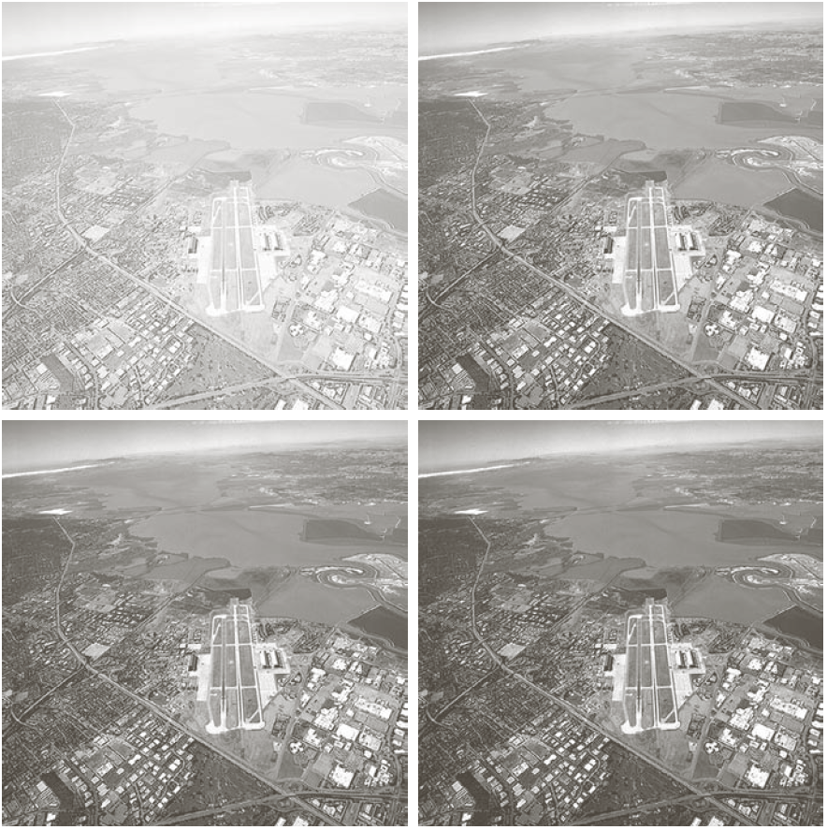
Example of Power-Law Transformations
image has a washed-out appearance, it needs a compression of gray levels
needs γ > 1
(b) result after power-law transformation with γ = 3.0 (suitable)
(c) transformation with γ = 4.0 (suitable)
(d) transformation with γ = 5.0 (high contrast, the image has areas that are too dark, some detail is lost)

Slide 19
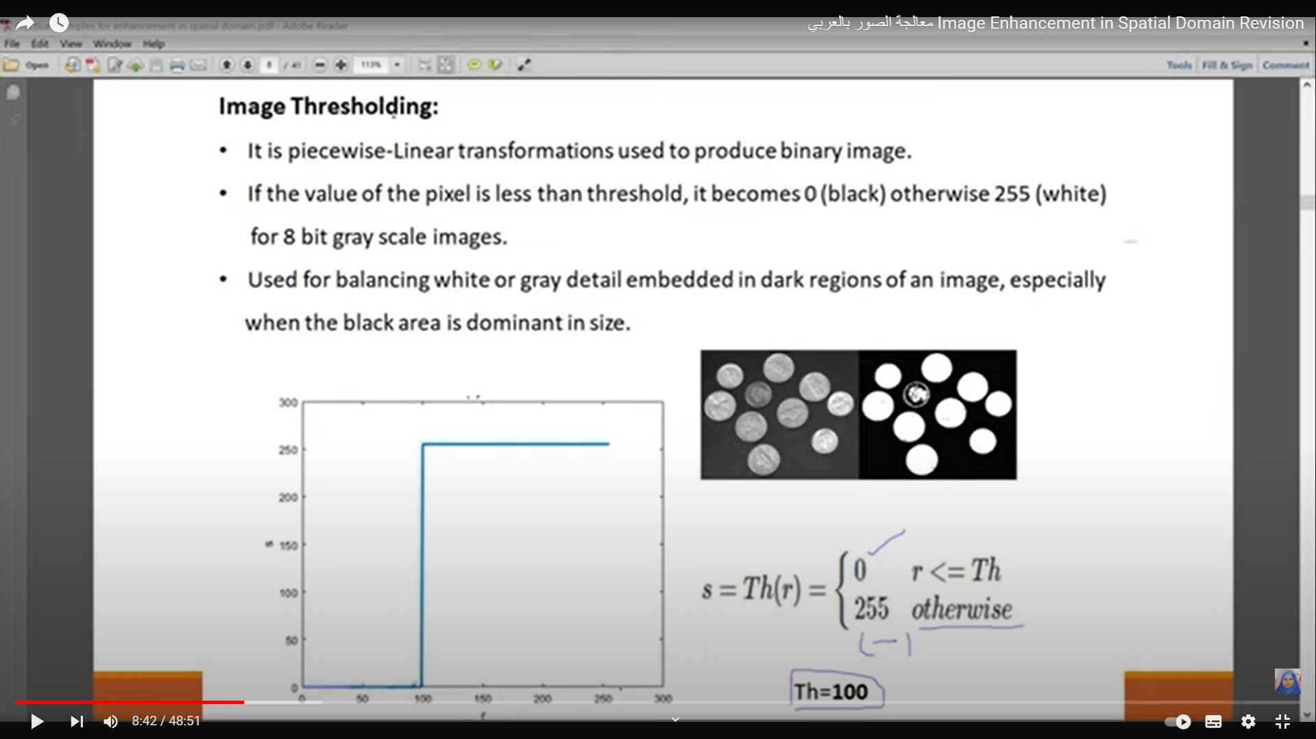
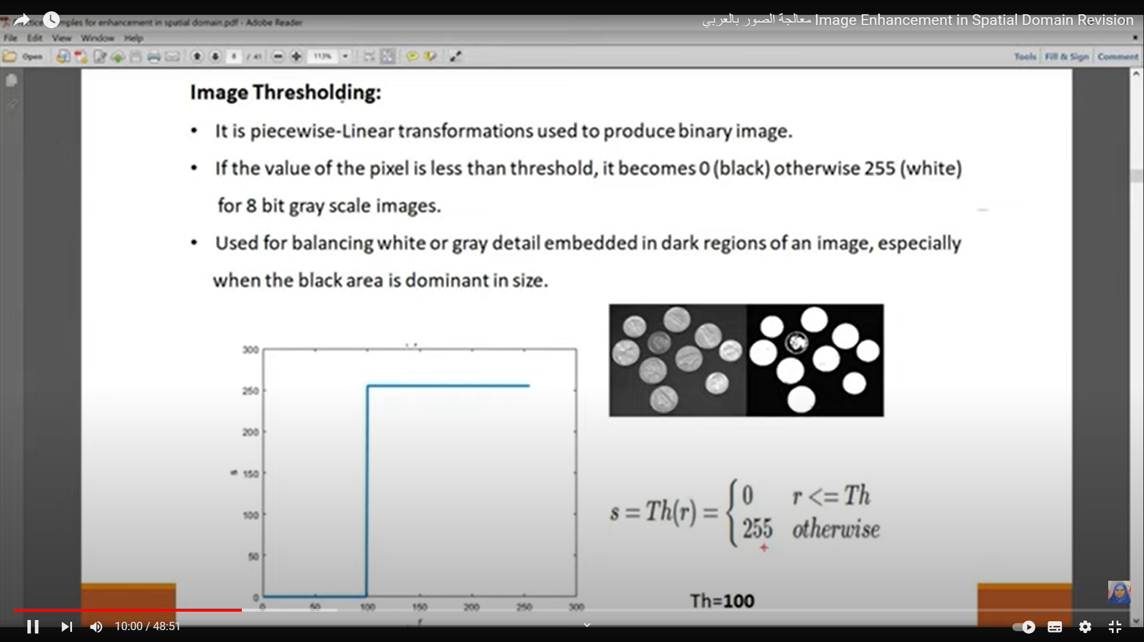
Image Thresholding
It is a piecewise-linear transformations used to produce binary image.
If the value of the pixel is less than threshold, it becomes 0 (black) otherwise 255 (white) for 8 bit gray scale images.
Used for balancing white or gray detail embedded in dark regions of an image, especially when the black area is dominant in size.

Slide 20
piecewise-linear transformations
Piecewise-linear transformations involve altering the intensity values of pixels in an image according to a linear function, but with different slopes and intercepts for different regions or segments of the image.
These transformations are often used for tasks such as contrast enhancement, brightness adjustment, and histogram equalization in image processing. By adjusting the slopes and intercepts of the linear functions for different segments, specific characteristics of the image can be enhanced or modified selectively.

Slide 21
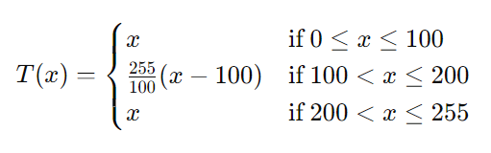
piecewise-linear transformations
Contrast Enhancement:
Suppose we have a grayscale image with intensity values ranging from 0 to 255. We want to enhance the contrast of the image by stretching the intensity values across the entire range.
Here's a simple piecewise-linear transformation for contrast enhancement:
For intensity values between 0 and 100, we'll leave them unchanged.
For intensity values between 101 and 200, we'll apply a linear transformation to stretch them across the range 0 to 255.
For intensity values between 201 and 255, we'll leave them unchanged.
So, the transformation function might look like this:

Slide 22
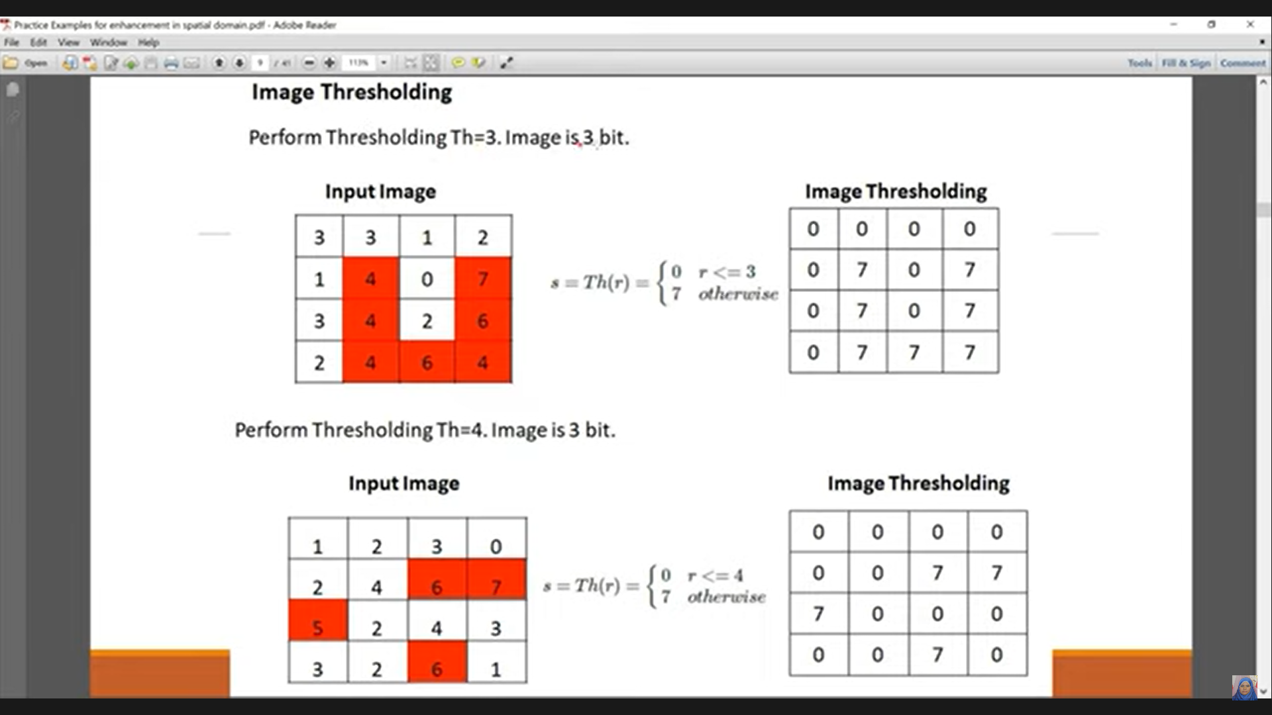
Exercises on Image Thresholding

Slide 23
Gray-level slicing
It is a piecewise-linear transformation and is equivalent to band pass filtering.
When we want to make certain ranges of intensity values look more prominent in the image, this is achieved by making a range of intensity values more brighter or darker compared to the background.
There are two approaches:
Gray-level Slicing without background
Highlight a range of intensities while diminishing all others to a constant low level.
Gray-level Slicing with background
Highlight a range of intensities but preserve all others.

Slide 24
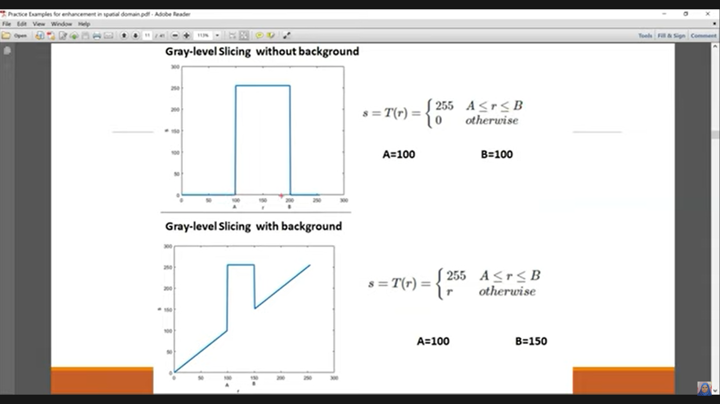
Gray-level slicing

Slide 25
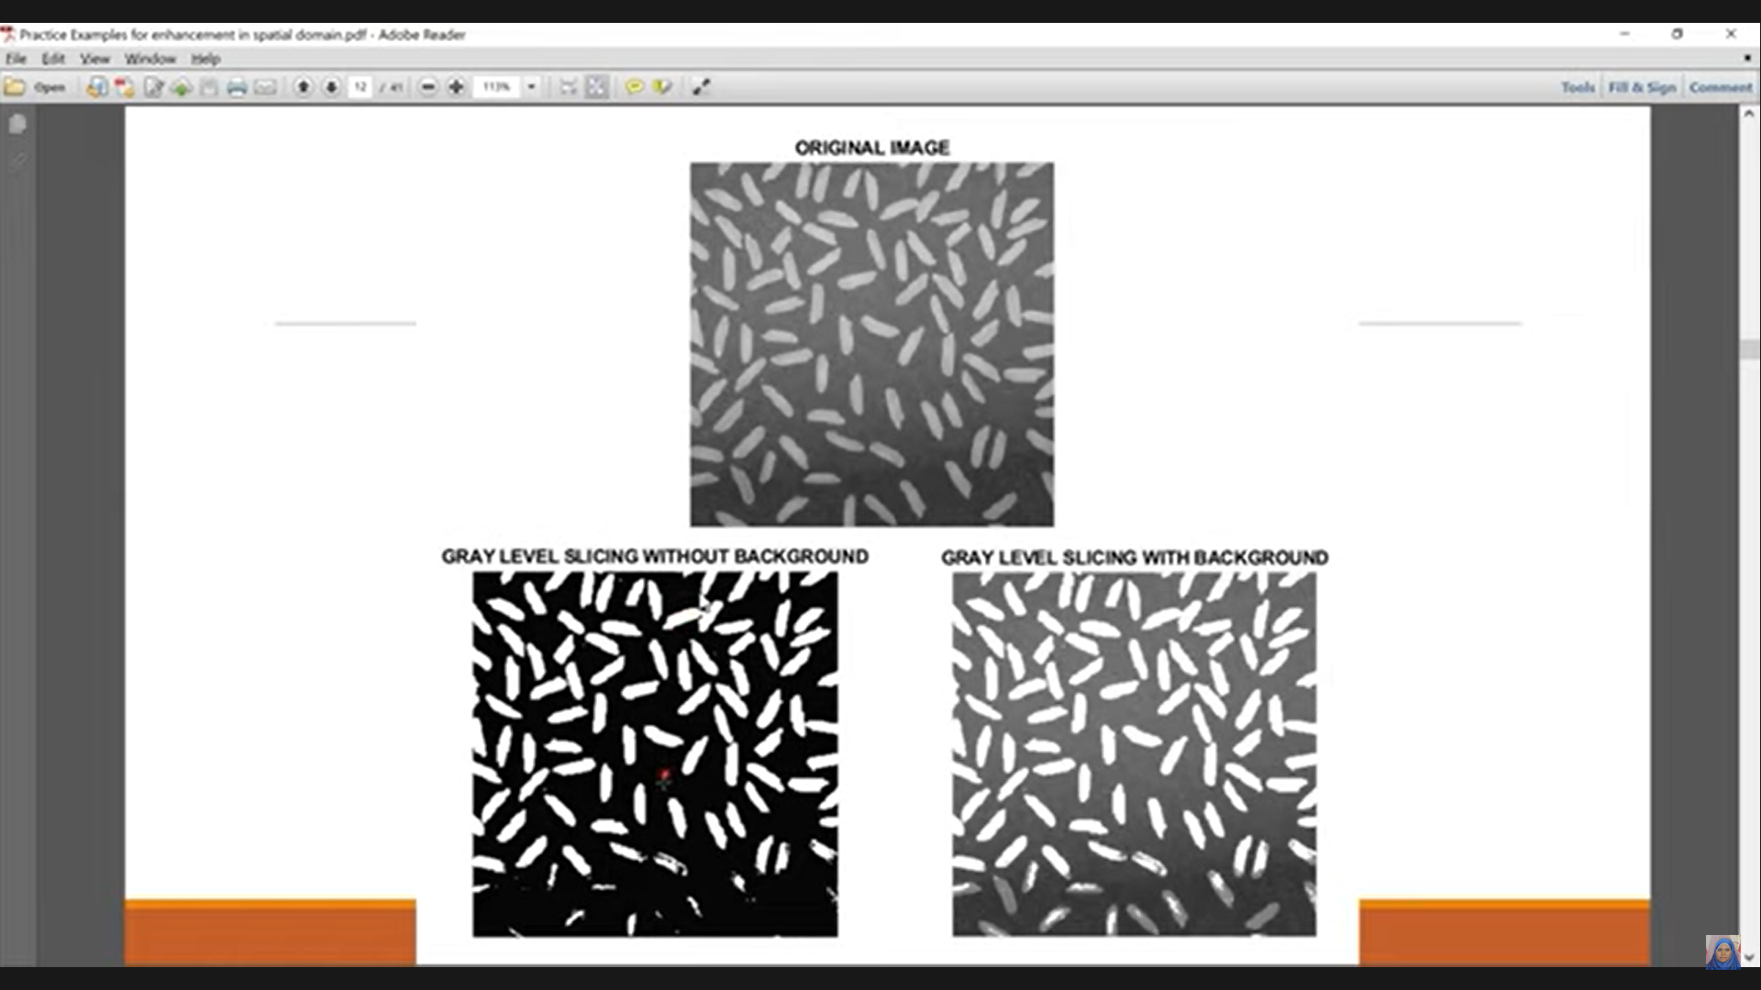
Example of Gray-level slicing

Slide 26
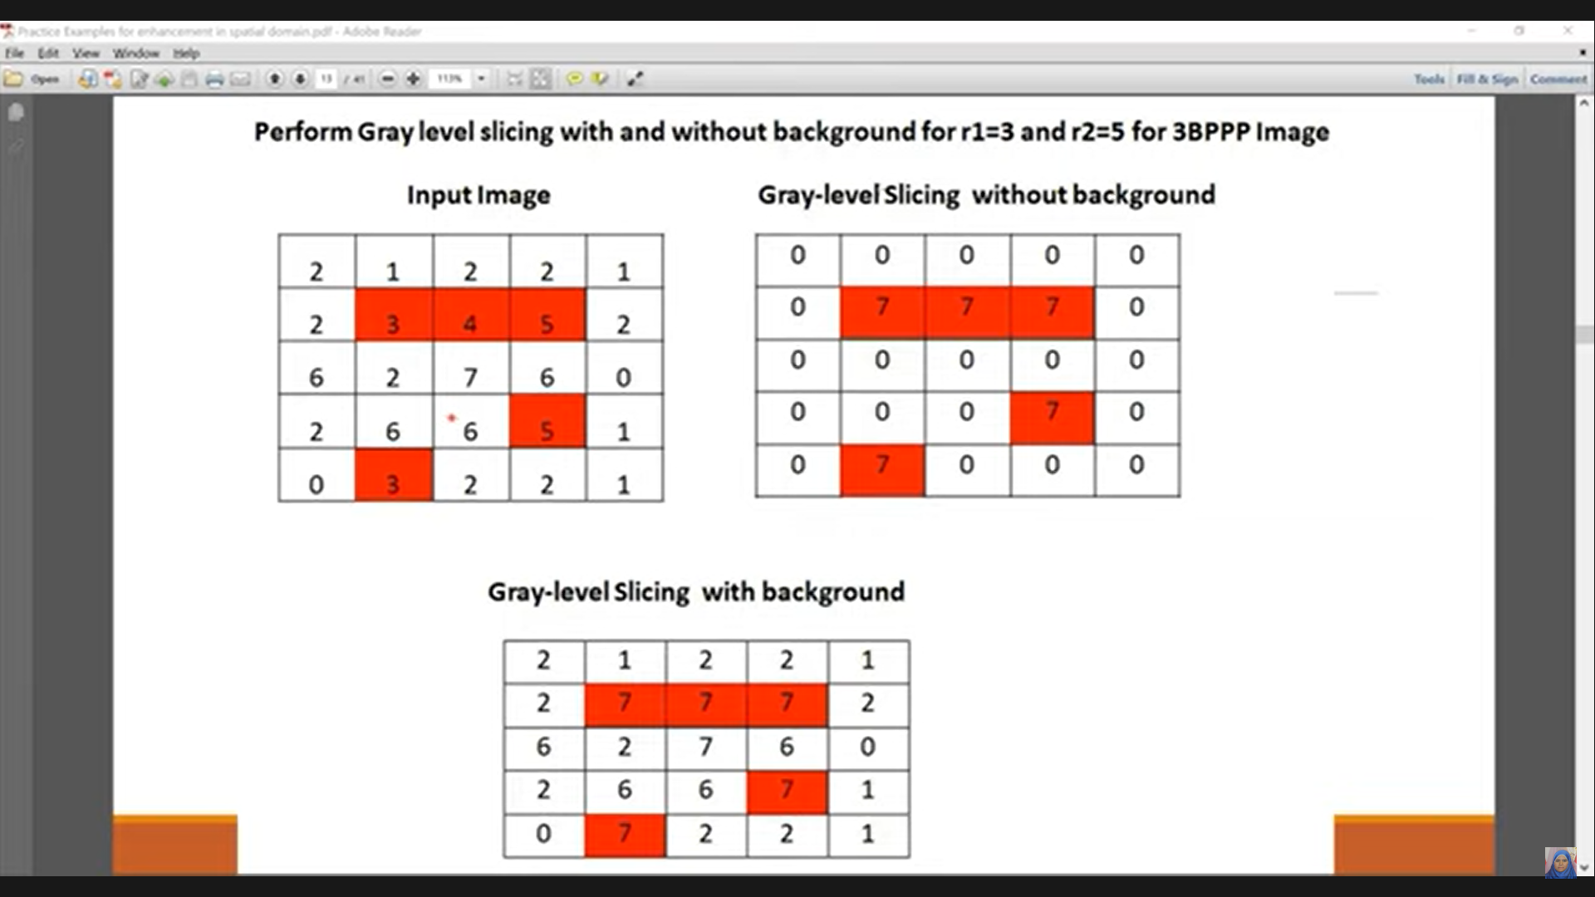
Exercises on Gray-level slicing

Slide 27
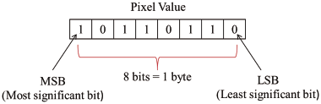
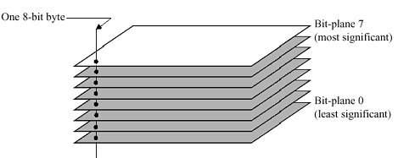
Bit plan slicing
To highlight the contribution made to the total image appearance by specific bits.
Assuming that each pixel is represented by 8 bits, the image composed of 8 1-bit planes.
Plane 0 contains the least significant bit and plane 7 contains the most significant bit.
Only the higher order bits (top four) contain visually significant data. The other bit planes contribute the more subtle details.

Slide 28
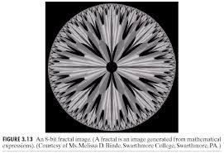
Example Bit plan slicing
The (binary) image for
bit-plane 7 can be obtained by processing the input image with a thresholding gray-level transformation.
Map all levels between 0 and 127 to 0
Map all levels between 129 and 255 to 255

Slide 29
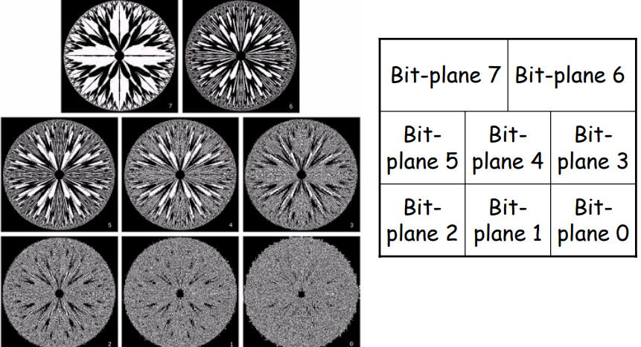
8 bit planes

Slide 30
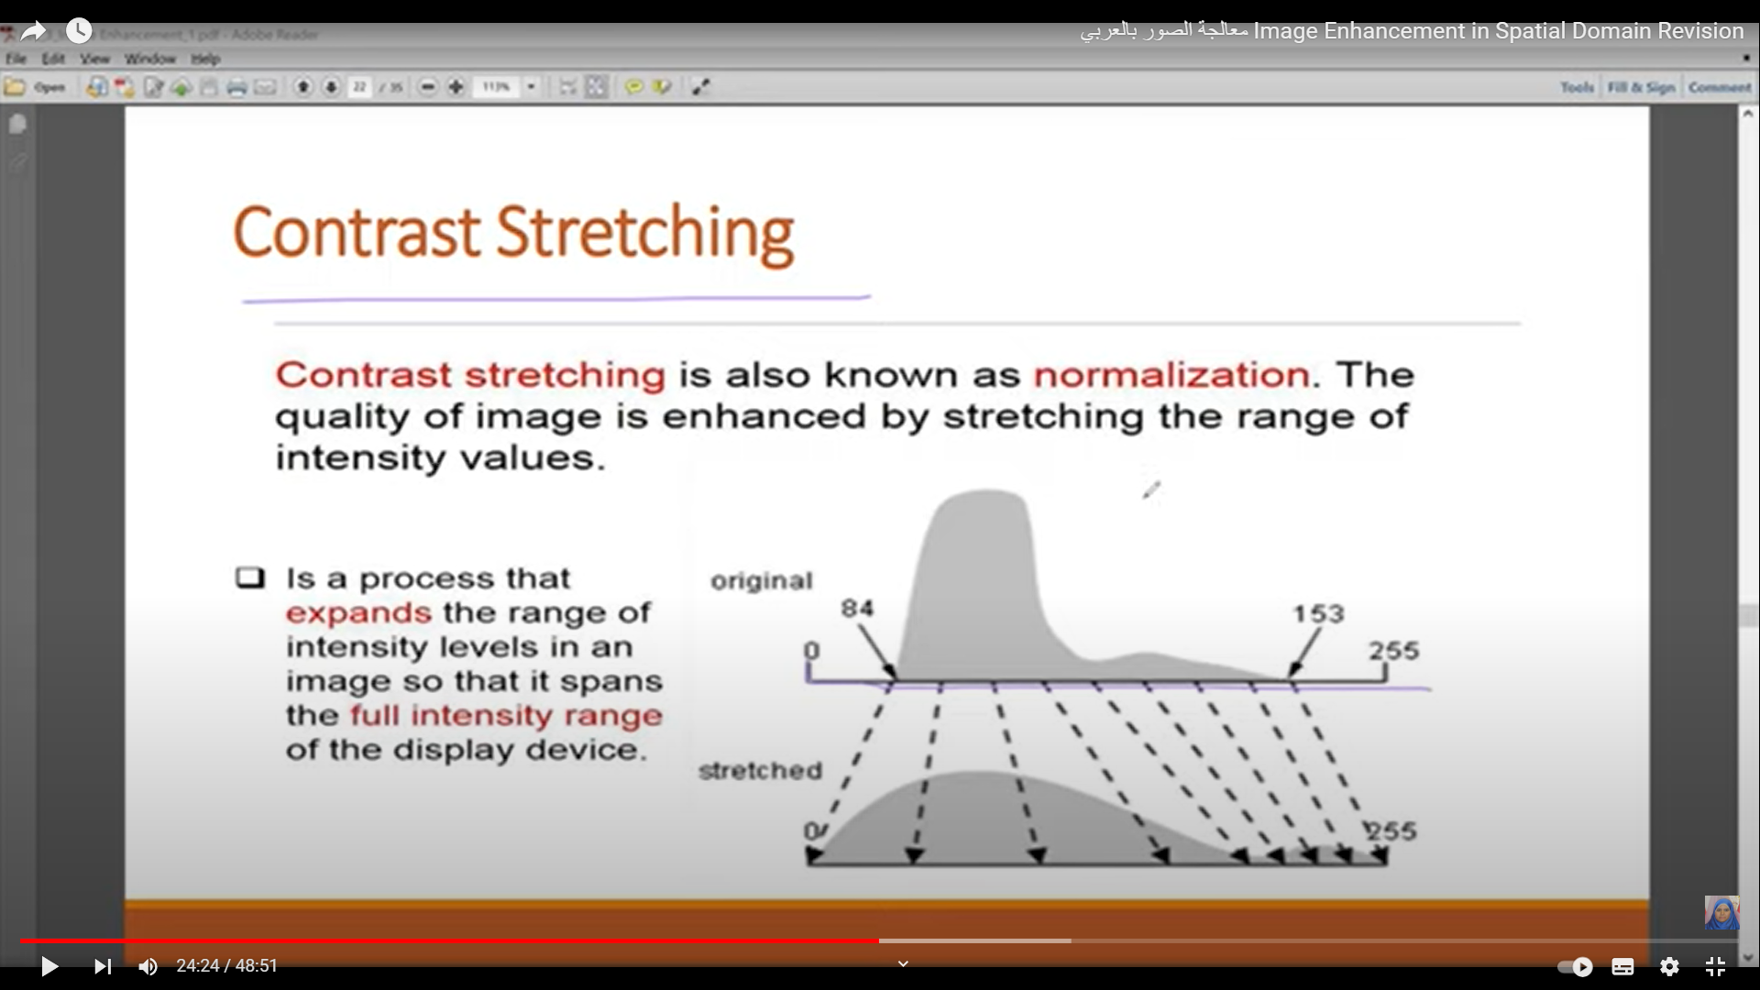
Contrast Stretching
Contrast Stretching is also know as normalization.The quality of image is enhanced by stretching The range of intensity values.
Is a process that expands the Range of intensity levels in an Image so that it spans the full intensity range of the display device

Slide 31
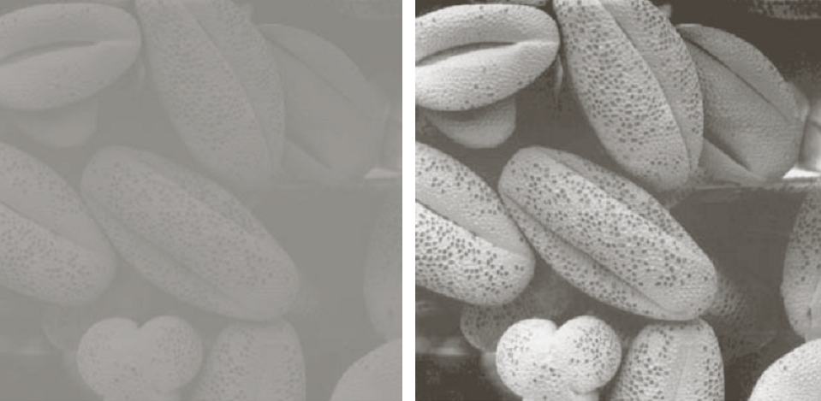
Contrast Stretching
Contrast Stretching, which means that the bright pixels in the image will become brighter and the dark pixels will become darker, this means: highr contrast image.

Slide 32
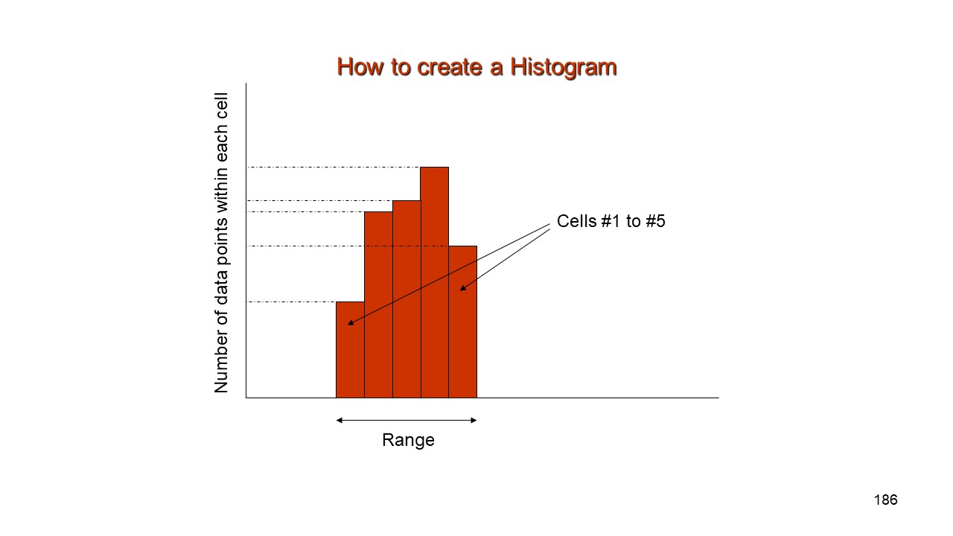
Histogram
What is a histogram?
A graph indicating the number of times each gray level occurs in the image, i.e. frequency of the brightness value in the image.
The image histogram carries important
information about the image content.
Algorithm:
Assign zero values to all elements of the array h₁;
For all pixels (x,y) of the image f, increment h[f(x,y)] by 1.

Slide 33
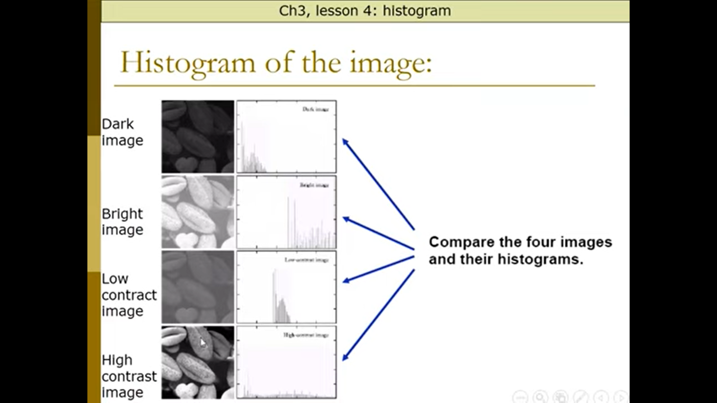
Histogram
Dark Image
Bright Image
Low Contrast Image
High Contrast Image

Slide 34
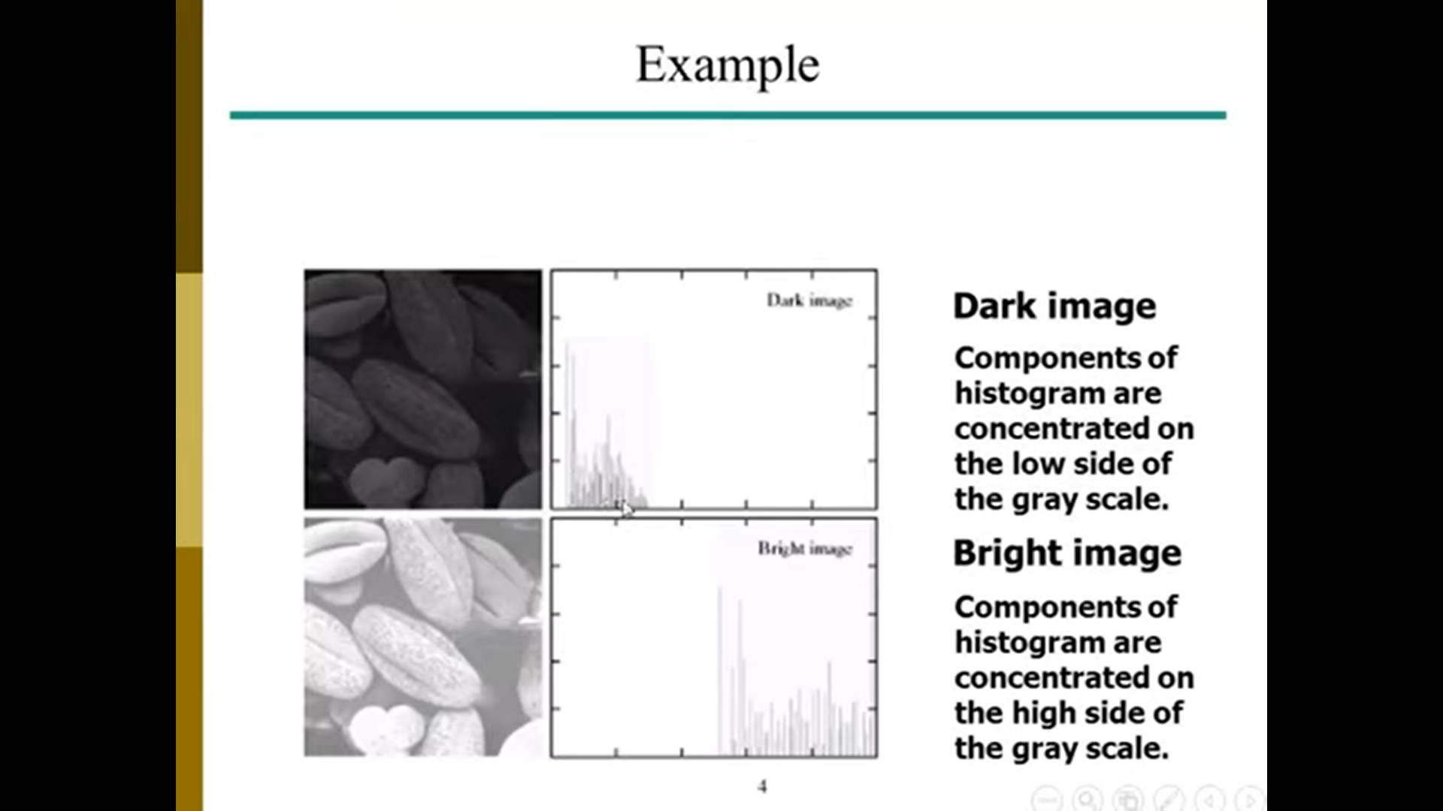
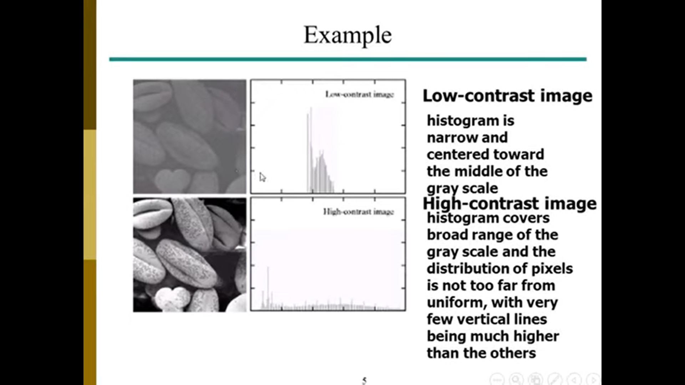
Example Histogram

Slide 35
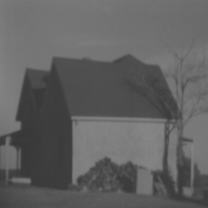
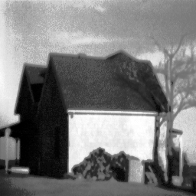
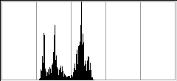
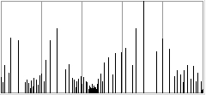
Histogram Equalization
Histogram equalization attempts to obtain an even distribution of intensity values in the image, often resulting in increased contrast.
Original image:
Histogram equalized image:

Slide 36
Histogram Equalization
At first, the continuous case will be studied:
r is the intensity of the image in [0, L-1].
we focus on transformations s=T(r):
T(r) is strictly monotonically increasing.
T(r) must satisfy:

Slide 37
Histogram Equalization
The condition for T(r) to be monotonically increasing guarantees that ordering of the output intensity values will follow the ordering of the input intensity values (avoids reversal of intensities).
If T(r) is strictly monotonically increasing then the mapping from s back to r will be 1-1 (one to one).
The second condition (T(r) in [0,1]) guarantees that the range of the output will be the same as the range of the input.

Slide 38
Histogram Equalization
Let the transformation s = T(r) satisfies the following conditions:
(a) T(r) is single-valued and monotonically increasing in the interval 0 ≤ r ≤ 1. We cannot perform inverse mapping (from s to r).
(b) 0 ≤ T(r) ≤ 1 for 0 ≤ r ≤ 1. Inverse mapping is possible.

Slide 39
Histogram Equalization
Let p_{r}(r) & p_{s}(s) denote the probability density functions (PDF) of random variables r & s, respectively.
Let the transformation:
We can view intensities r and s as random variables and their histograms as PDFs p_{r}(r) and p_{s}(s).
The PDF of the output levels is uniform, i.e., the above transformation generates an image whose intensity levels are equally likely and cover the entire range [0, 1].
For discrete quantities we work with summations, and the above transformation becomes:
for k = 1, 2, …, L.

Slide 40
Histogram Equalization
Given histogram of image (gray-level values & their numbers)
Step 1: Normalize the number of gray-levels values by dividing by the total number of pixels.
Step 2: Create a running sum (cumulative) of the histogram values.
Step 3: Multiply these values by the maximum gray-level value and then round the result to the closest integer.
Step 4: Map the original values to the results from step 3 by a one-to-one correspondence.

Slide 41
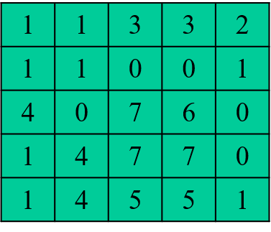
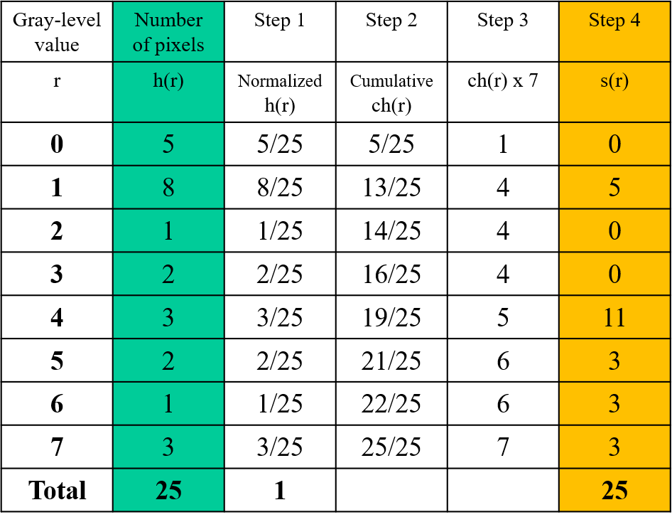
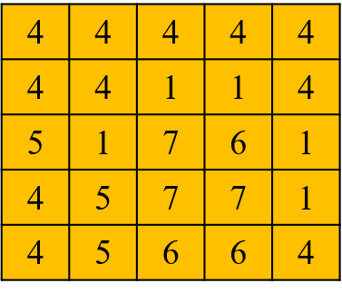
Histogram Equalization
Exercises : Consider a 5x5 image with 3 bits/pixel:

Slide 42
Spatial Filtering
The Spatial Filtering consists of:
Neighborhood, (typically a small rectangle).
Predefined operation that is performed on the image pixels by the neighborhood.
Filtering creates a new pixel with coordinates equal to the coordinates of the center of the neighborhood, and whose value is the result of filtering operation.
Spatial Filtering:
Linear spatial filtering
Nonlinear spatial filtering

Slide 43
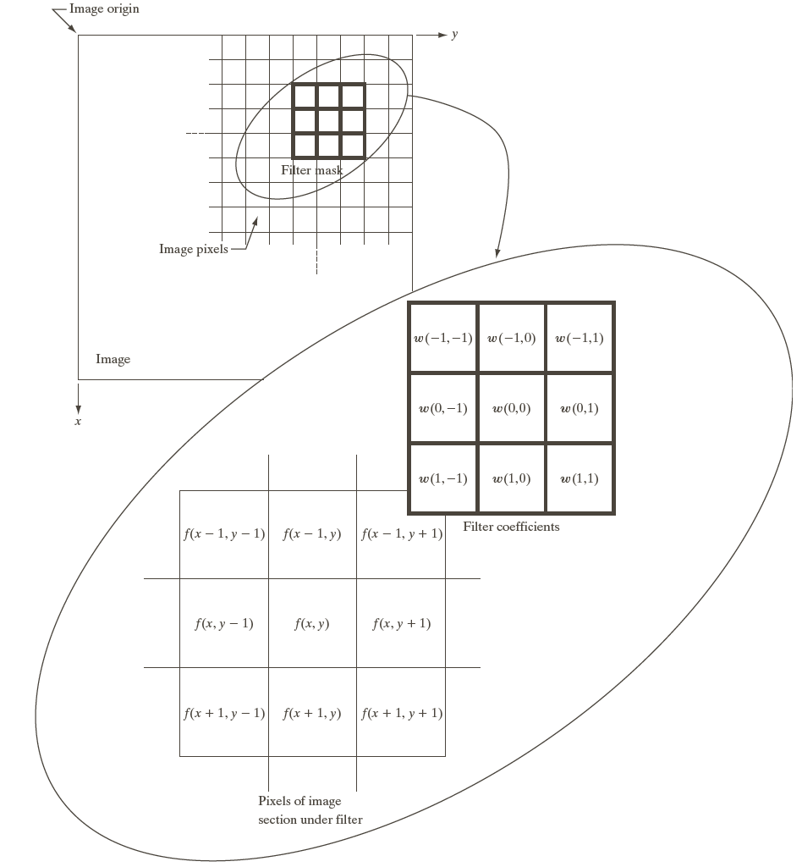
Spatial Filtering (Neighborhood Processing)
f₁ f₂ f₃
f₄ f₅ f₆
f₇ f₈ f₉
Linear Spatial Filtering@ Nonlinear Spatial Filtering
Mask Size: m x n
We assume that m = 2a+1, n = 2b+1 where a and b are non-negative integers

Slide 44
Spatial Filtering (Neighborhood Processing)
f₁ | f₂ | f₃
f₄ | f₅ | f₆
f₇ | f₈ | f₉
f₁ f₂ f₃
f₄ f₅ f₆
f₇ f₈ f₉
Linear Spatial Filtering
w₁ | w₂ | w₃
w₄ | w₅ | w₆
w₇ | w₈ | w₉
g₅ = f₁*w₁+ f₂*w₂+ f₃*w₃+ f₄*w₄+ f₅*w₅+ f₆*w₆+ f₇*w₇+ f₈*w₈+ f₉*w₉

Slide 45
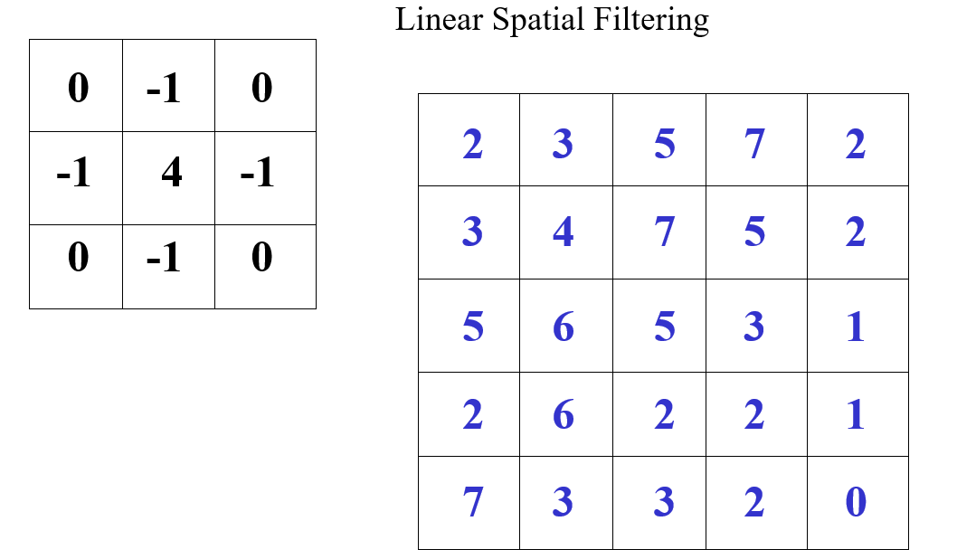
Spatial Filtering (Neighborhood Processing)

Slide 46
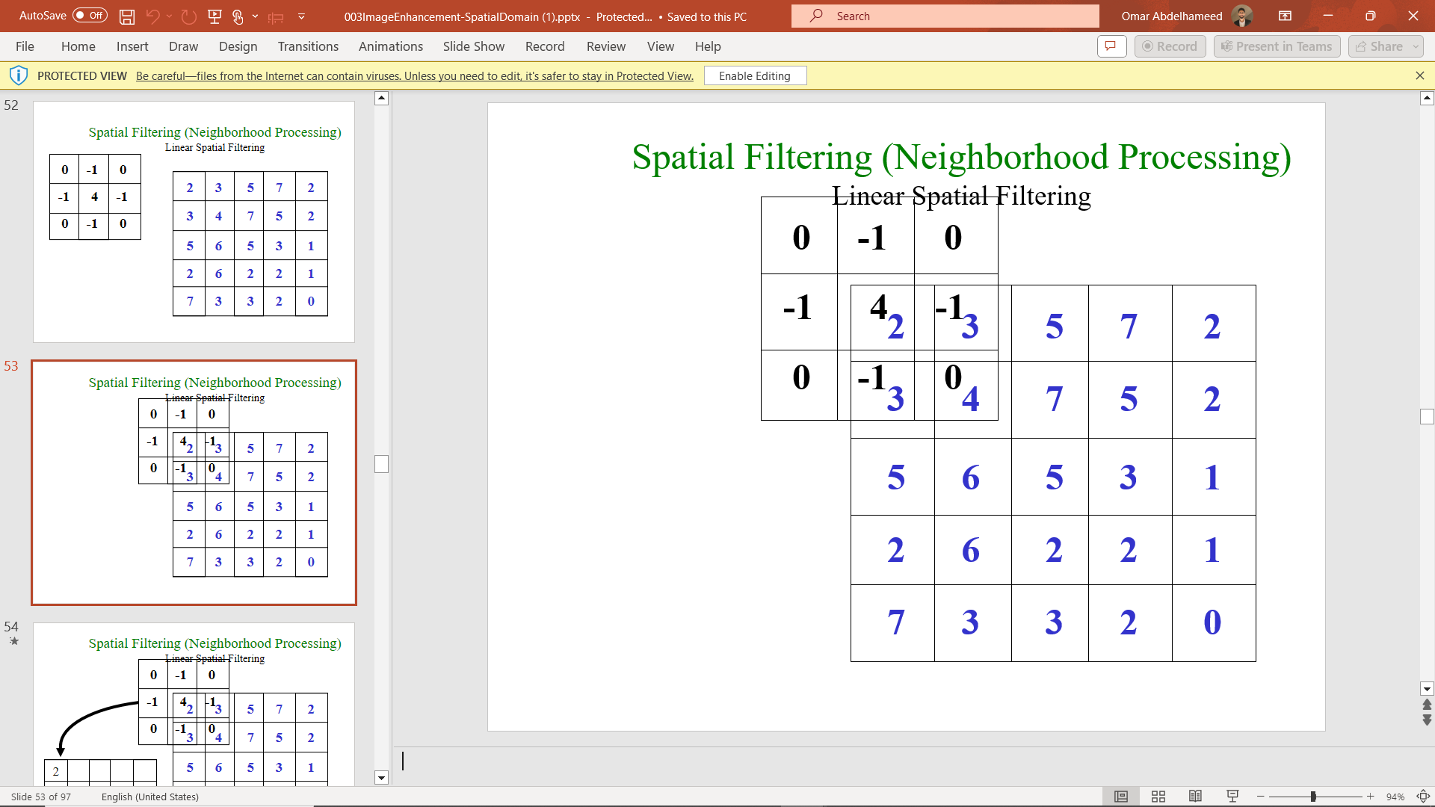
Spatial Filtering (Neighborhood Processing)

Slide 47
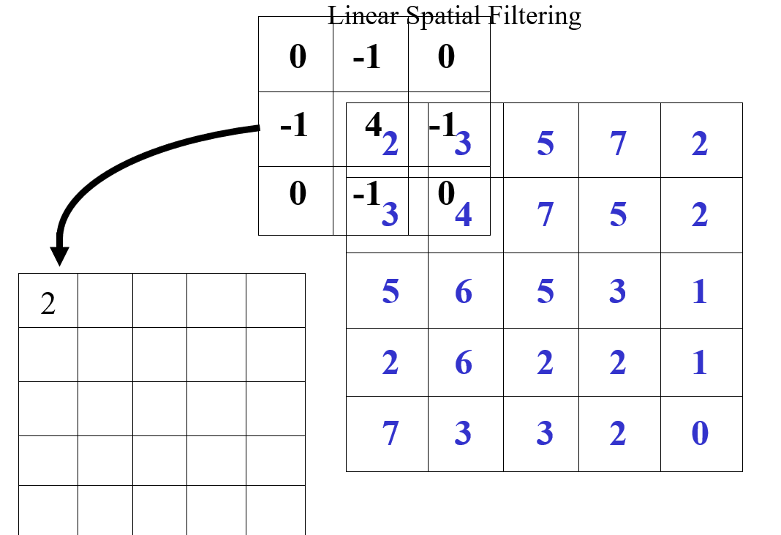
Spatial Filtering (Neighborhood Processing)

Slide 48
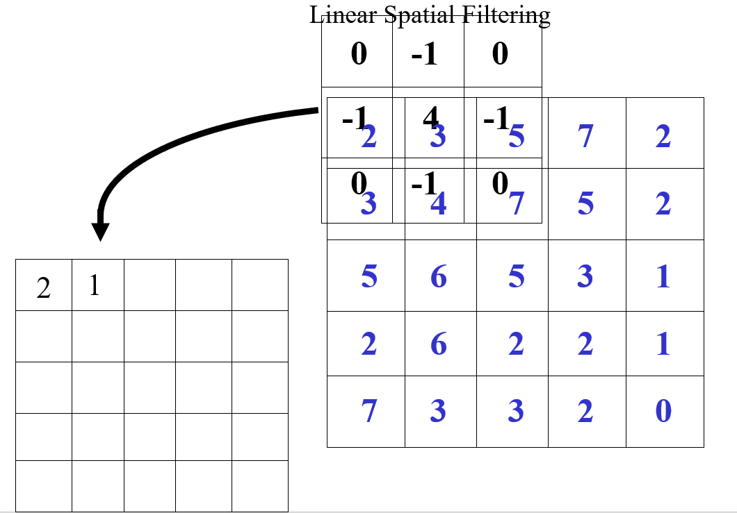
Spatial Filtering (Neighborhood Processing)

Slide 49
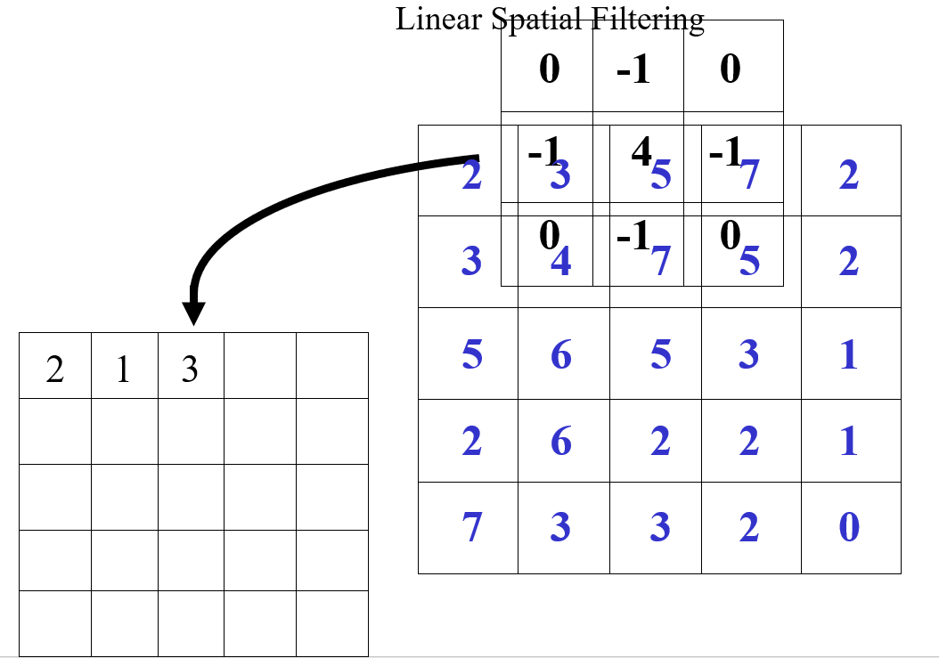
Spatial Filtering (Neighborhood Processing)

Slide 50
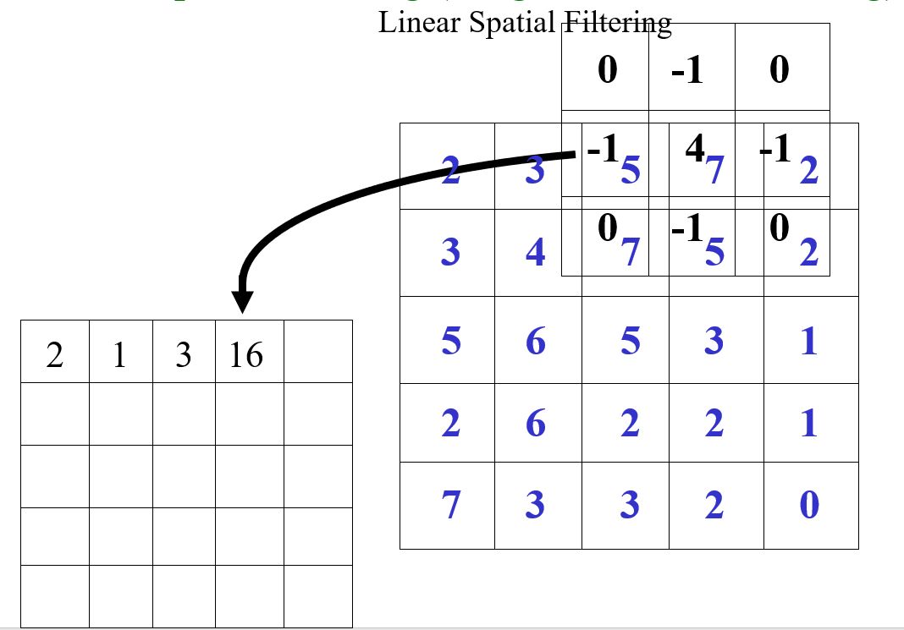
Spatial Filtering (Neighborhood Processing)

Slide 51
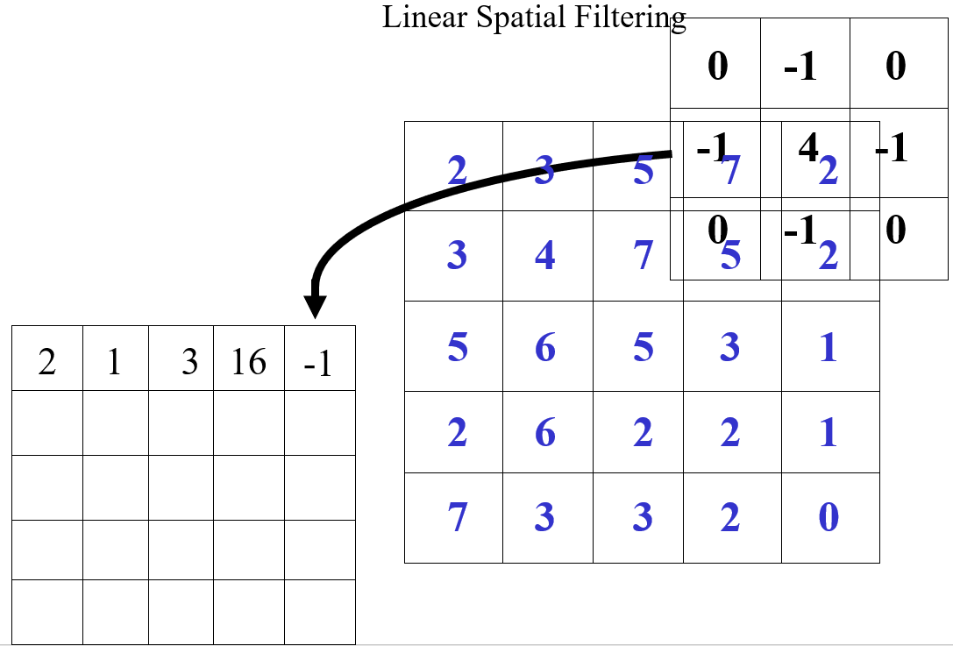
Spatial Filtering (Neighborhood Processing)

Slide 52
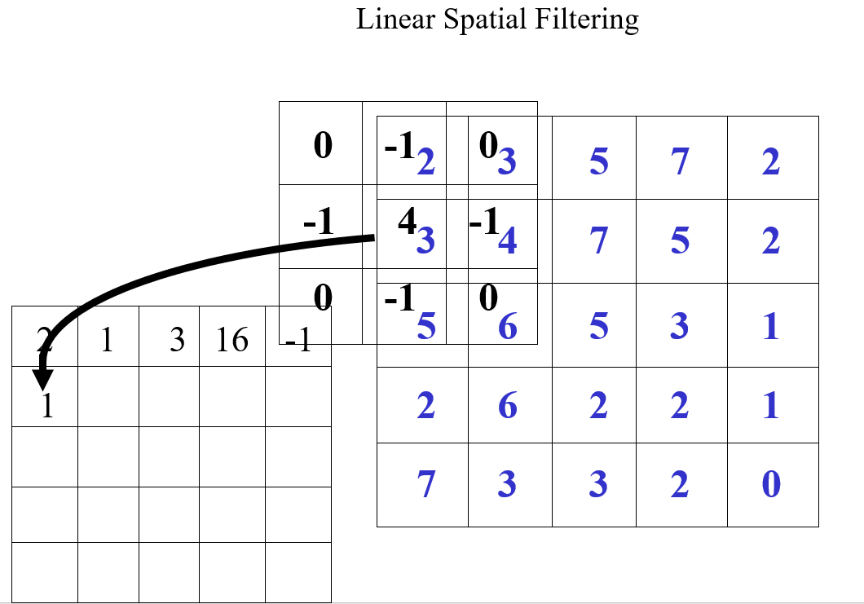
Spatial Filtering (Neighborhood Processing)

Slide 53
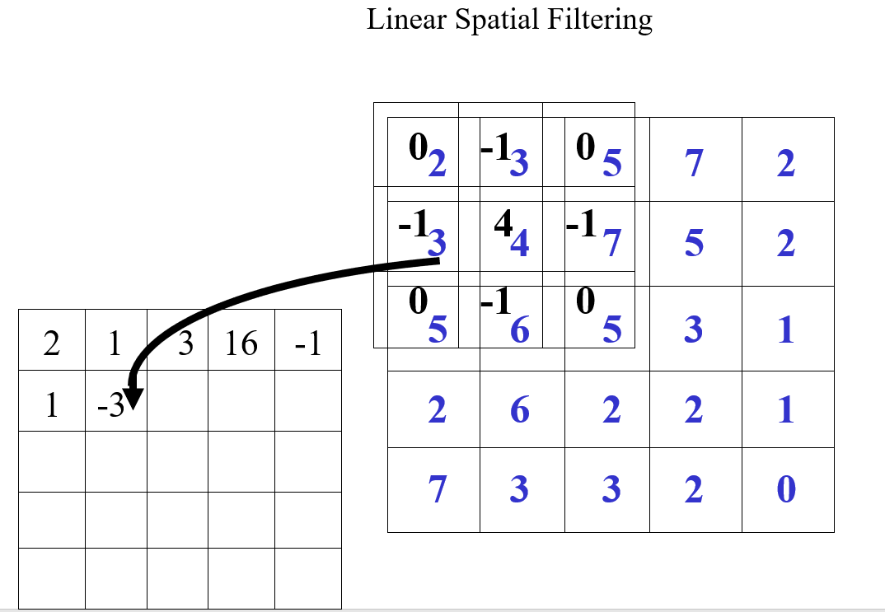
Spatial Filtering (Neighborhood Processing)

Slide 54
Basics of Spatial Filtering
In spatial filtering (vs. frequency domain filtering), the output image is computed directly by simple calculations on the pixels of the input image.
Spatial filtering can be either linear or non-linear.
For each output pixel, some neighborhood of input pixels is used in the computation.
In general, linear filtering of an image f of size MxN with a filter mask of size mxn is given by
where a=(m-1)/2 and b=(n-1)/2
This concept is called convolution. Filter masks are sometimes called convolution masks or convolution kernels.

Slide 55
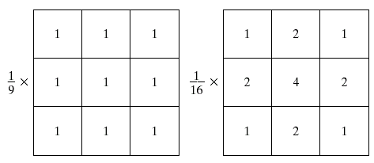
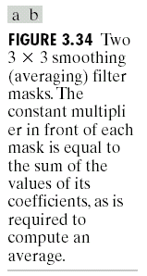
Smoothing Spatial Filters
Smoothing linear filters
Averaging filters (Lowpass filters in Chapter 4))
Box filter
Weighted average filter
Box filter
Weighted average

Slide 56
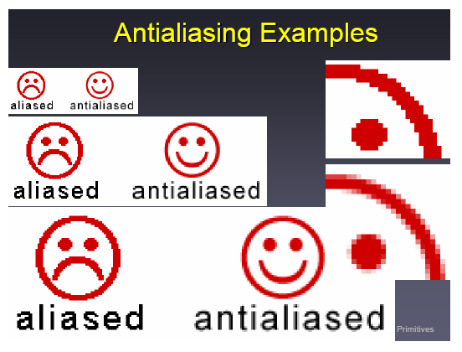
Smoothing Spatial Filters
Which mask is suitable for anti-aliasing?
Box filter
Weighted average
Box filter
Weighted average

Slide 57
Smoothing Spatial Filters
The general implementation for filtering an M x N image with a weighted averaging filter of size m x n is given by
where a=(m-1)/2 and b=(n-1)/2

Slide 58
References
Digital Image Processing (third edition):
Chapter 3: Image Enhancement in the Spatial Domain.
Gonzalez R. C., Woods R. E., Digital Image Processing, Pearson Education, Second Edition, 2006.
https://youtu.be/fyO9S1UMhcs?si=juqP2R8-nuyQjOyu
https://youtu.be/5G6Qrr7OJcA?si=hb4TEzl4xh1wbuh9
https://youtu.be/K0FL3gTcJH8?si=CuAxMqKn9_mDU7Yi

Slide 59
Thank you

